Slide 1
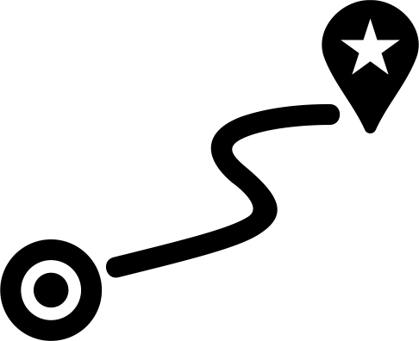

1 mi

Slide 2



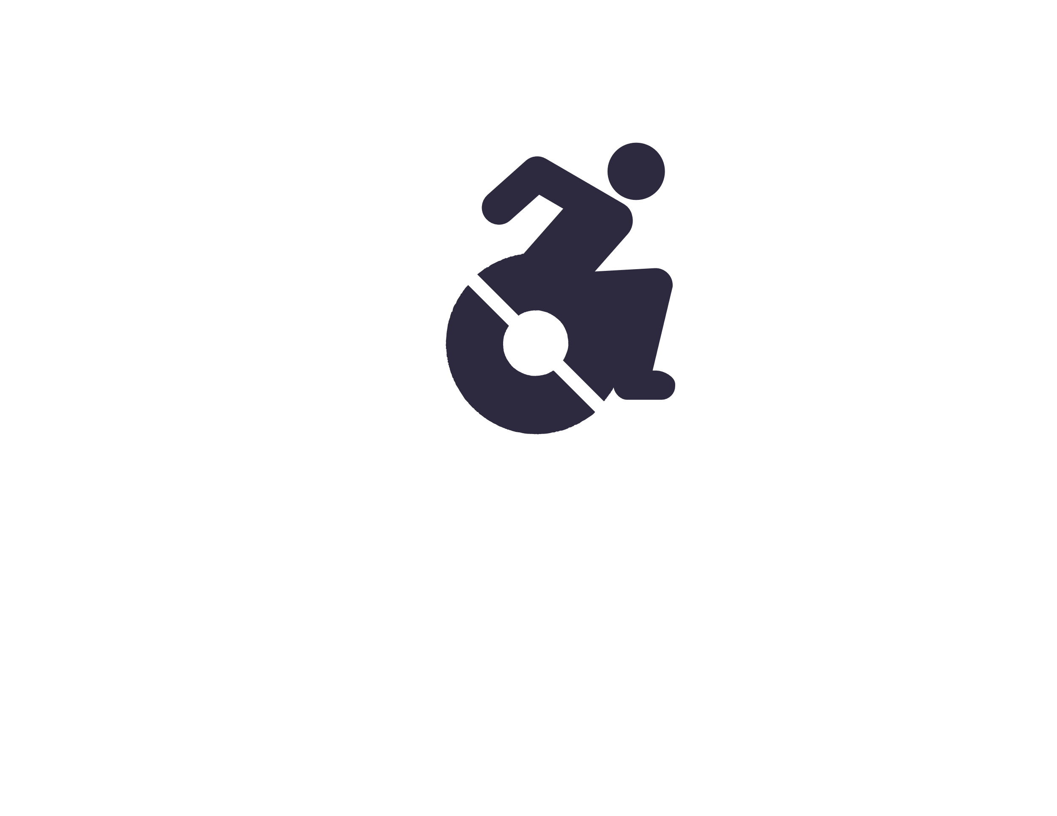






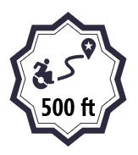
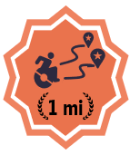
500 ft
0.25 mi
0.5 mi
1 mi
5 mi
500 ft
500 ft
0.25 mi
0.5 mi
500 ft
500 ft
50

Slide 3


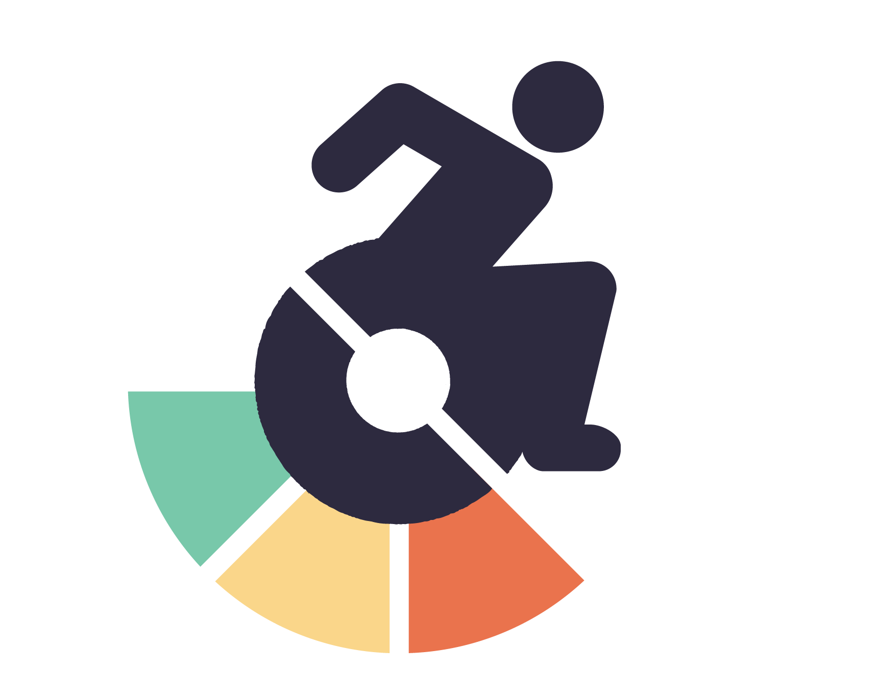
100
500
1k
5k

Slide 4

100
250
500
1k
5k
100
250
500
1k
5k
100
250
500
1k
5k
100
250
500
1k
5k

Slide 5
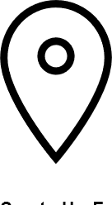


100
250
500
1k
5k
50
250
500
1k
5k
250

Slide 6



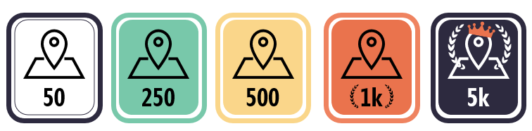
100
250
500
1k
5k
50
250
500
1k
5k
50
250
500
1k
5k
250

Slide 7
50
250
500
1k
5k

Slide 8





10
100
10
10
5
10
20
5
20
20
20
5
10
20
50
100

Slide 9



5
10
20
50
100
100

Slide 10



1st
1st
1st

Slide 11
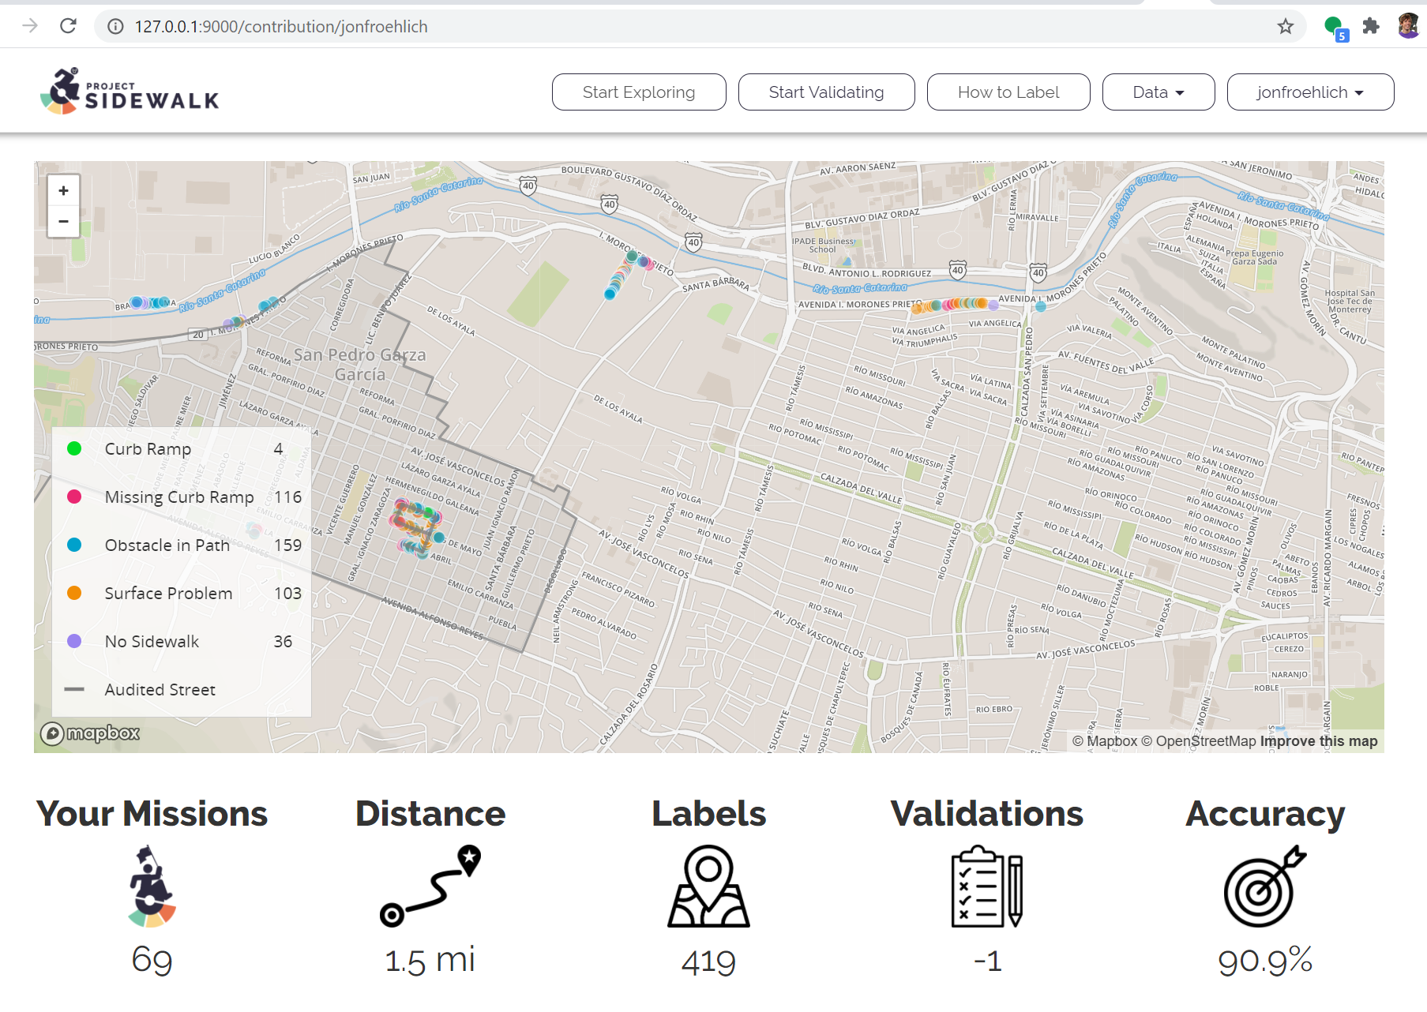


Achievements

Slide 12

1st
Achievements
Missions
Validations
Just 3 more missions until your next achievement!
223 more validations until your next achievement!

Slide 13

Badges for:
Most accurate
Distance levels (0.5 mi, 1 mi, 5 mi, 10 mi+)
Num Labels (100, 500, 1k, 10k, 50k, 100k)
Num missions
Num validations

Slide 14
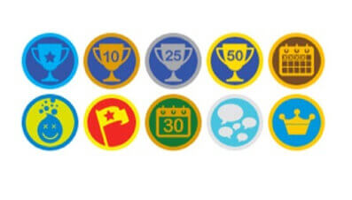



Slide 15
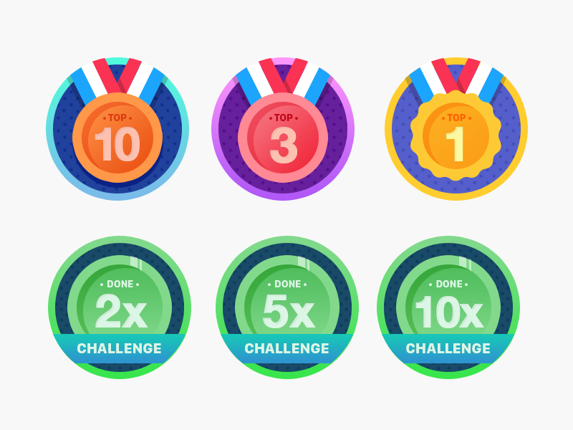

Slide 16

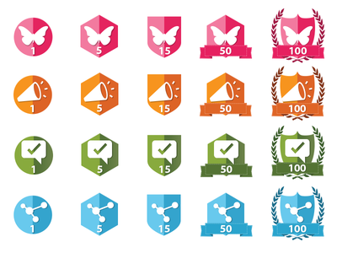


Notes:
https://thenounproject.com/search/?q=wreath&i=203146

Slide 17


Slide 18
